Slide 1
CS97: Introduction to Data Science
Please only sit in the first 5 rows
Please try to sit in the middle
Pick up your name badge in the front desk
Last name A-L
Last name M-Z

Slide 2
CS97: Introduction to Data Science
1: Introduction
Instructor: Shichang Zhang
shichang@ucla.edu
June 23, 2024

Slide 3
Instructor Information
Instructor: Shichang Zhang
Email: shichang@ucla.edu
Pronoun: he/him/his
A recently graduated UCLA PhD
Will join Harvard as a Postdoctoral Fellow in August
Attended Berkeley and Stanford

Slide 4
TA Information
Amin Doosti (doostiamin@ucla.edu)
Howard Zhu (howardzhu8@gmail.com)
Weikai Li (weikaili@cs.ucla.edu)
Zongyue Qin (qinzongyue@cs.ucla.edu)

Slide 5
Ice Breaker Questions
Introduce yourself to your neighbors
E.g., name, grade, hometown
Why do you choose CSSI introduction to data science track?

Slide 6
Logistics of CSSI Intermediate Track CS 97
Basic structure
Mornings (9am-11:50pm):
Lecture time
One or two breaks in the middle
Afternoons (1pm-4pm):
Small cohort (a) discussion sessions and (b) labs led by TAs
Seminar days (06/28 & 07/08) afternoons:
1-2:30 pm, seminars by guest speakers
Last Day
Course project presentation by every team

Slide 7
Classrooms
Morning lecture: BH 3400
Afternoon discussion and lab
Amin Doosti: classroom MS 3915D
Howard Zhu: classroom MS 3915H
Weikai Li: classroom MS 3915G
Zongyue Qin: classroom MS 6201
For today, come back to BH 3400 at 1pm and your TA will lead you to the classroom for the afternoon session.
In case you want to switch your section, you need to
1. Talk to both TAs for their approval
2. Find another student in the other section to switch with you

Slide 8
Grading
Homework: 40%
Midterm exam: 25%
Course project: 30%
Participation: 5%

Slide 9
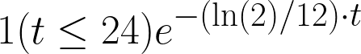
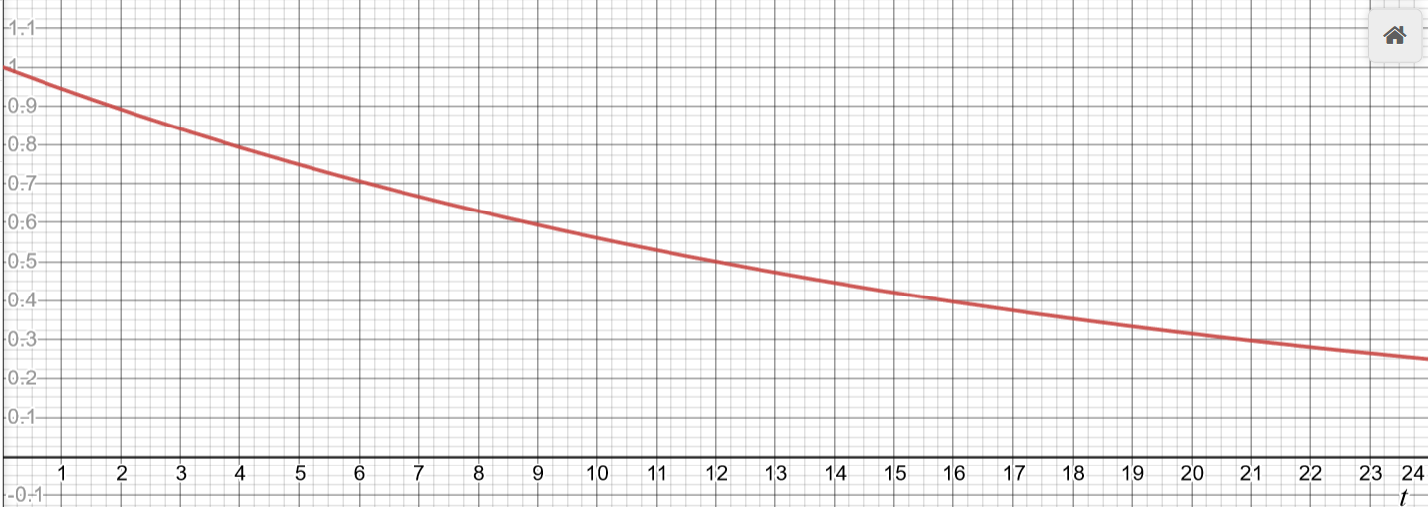
Grading: Homework
Homework: 40%
4 assignments (homework 0 is not counted towards your grade)
Deadline: 10:00 pm of the indicated due date via BruinLearn system
Late submission policy: get original score multiplied by
if you are t hours late.
No copying or sharing of homework!
You can discuss the problems and ideas with others, but you MUST write your own homework
No AI models allowed (e.g., ChatGPT)
Suspicious cases will be reported to The Office of the Dean of Students
We will help you with homework assignments related questions in afternoon sections

Slide 10
Grading: Midterm Exam
Midterm exam (1:00-3:00pm, 7/9): 25%
Closed book exam
No Internet search
No communication with other people
Simple calculators allowed

Slide 11
Grading: Course Project
Course project: 30%
Group project (4-5 people for one group)
Goal: Solve a data science problem
E.g., Yelp review sentiment analysis
TA guided
Presentation on the last day
Submit your slides and code link in BruinLearn
Milestone (first idea implemented) by the end of the second week (5%)

Slide 12
Grading: Participation
Participation (5%)
In-class participation
ask/answer questions
slido
Online participation (Piazza)
piazza.com/ucla/summer2024/cs97

Slide 13
Conflicts and Special Accommodation Requests
Missing classes will affect your participation score
You may miss up to two lectures/discussions without participation penalty, but you MUST let BOTH the instructor and your TA know IN ADVANCE that you will be missing
However, missing one day means you miss 1/13 of the material
Talk to the instructor after today’s lecture (at 12 pm) if you need special accommodations
E.g., you cannot come to the exam or the project presentation

Slide 14
Textbooks (Optional)
References
Fundamentals of Machine Learning for Predictive Data Analytics Algorithms, Worked Examples, and Case Studies. John D. Kelleher, Brian Mac Namee, Aoife D’Arcy
Machine Learning: An Algorithmic Perspective, Second Edition Part of: Chapman & Hall/Crc Machine Learning & Pattern Recognition (21 Books) | by Stephen Marsland.
Python for data analysis: Data wrangling with Pandas, NumPy, and IPython. O'Reilly Media, Inc., 2012 | by McKinney, Wes.
Probabilistic programming and Bayesian methods for hackers., 2015 | by Pilon, Cameron Davidson.
More References
Jiawei Han, Micheline Kamber, and Jian Pei. Data Mining: Concepts and Techniques, 3rd edition, Morgan Kaufmann, 2011
"Data Mining: The Textbook" by Charu Aggarwal (http://www.charuaggarwal.net/Data-Mining.htm)
"Data Mining" by Pang-Ning Tan, Michael Steinbach, and Vipin Kumar (http://www-users.cs.umn.edu/~kumar/dmbook/index.php)
"Machine Learning" by Tom Mitchell (http://www.cs.cmu.edu/~tom/mlbook.html)
"Introduction to Machine Learning" by Ethem ALPAYDIN (http://www.cmpe.boun.edu.tr/~ethem/i2ml/)
"Pattern Classification" by Richard O. Duda, Peter E. Hart, David G. Stork (http://www.wiley.com/WileyCDA/WileyTitle/productCd-0471056693.html)
"The Elements of Statistical Learning: Data Mining, Inference, and Prediction" by Trevor Hastie, Robert Tibshirani, and Jerome Friedman (http://www-stat.stanford.edu/~tibs/ElemStatLearn/)
"Pattern Recognition and Machine Learning" by Christopher M. Bishop (http://research.microsoft.com/en-us/um/people/cmbishop/prml/)

Slide 15
About CS 97
It is adapted from CS 141: data science fundamentals (Prof. Baharan Mirzasoleiman) and CS 145: introduction to data mining (Prof. Yizhou Sun)

Slide 16
Syllabus
All the logistics we have covered so far can be found on the Syllabus, where we also provide a detailed tentative schedule
BruinLearn

Slide 17
Prerequisites
Some background in calculus, linear algebra, and statistics
A math refresher will be provided as homework 0
Familiarity with (basic) Python
We are here to help!

Slide 18
A few words before we start
This is a dense course, and we have lots of materials to cover.
On top of that, we have a fast-paced schedule.
If you feel stressed, please let us know and we are here to help.
Our goal (and my job) is not to scare you but to help you learn the material and enjoy the learning journey.

Slide 19
The role of mathematics
Personally, I absolutely love math.
However, this is NOT a math class
You will see mathematical equations and formulations, but the goal of math is to help us formulate the problem and understand the concepts, so math itself is not the goal, but the means to an end.
I will do some math derivations in class and share the notes for complex ones on BruinLearn.
At the current level, intuition is always the most important.

Slide 20
Learning objectives
Know-what:
What is data science
What are the basic algorithms
Know-how:
How does each algorithm work and how to implement these algorithms using python
How to solve real world problems with these algorithms
Know-why:
Why does each algorithm work
What are the principles behind each algorithm design
Intuitively
Mathematically (optional)

Slide 21



Please download and install the Slido app on all computers you use
Audience Q&A Session
ⓘ Start presenting to display the audience questions on this slide.

Slide 22
1. Introduction
Why data science?
What is data science?
What are the data?
What makes it "science"?
What are the functions?
What is a typical life cycle?
Content covered by this course

Slide 23
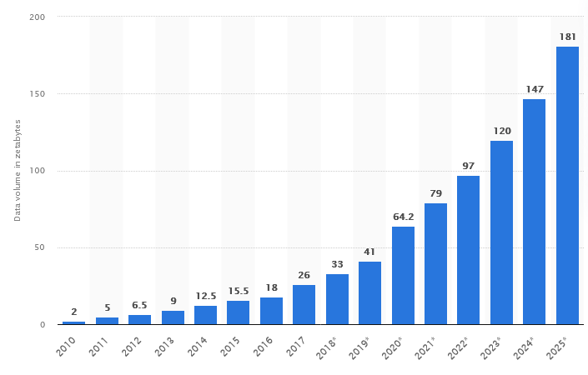
Big Data
In Zeta Bytes
1 Zeta byte = 1 trillion Gigabytes.
10T of data for every person on Earth in 2022.
https://www.statista.com/statistics/871513/worldwide-data-created/

Slide 24
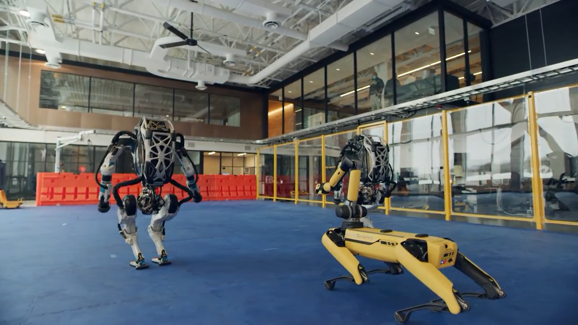
Why am I excited about data science?

Slide 25
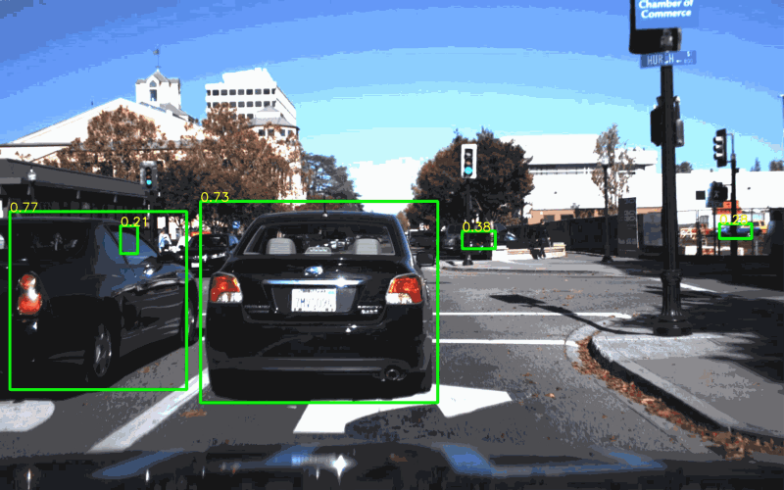
Why am I excited about data science?

Slide 26
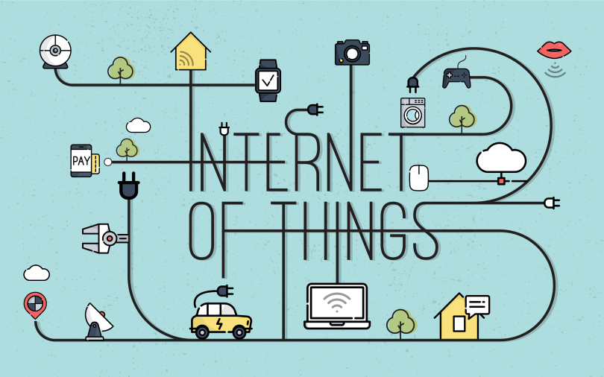
Why am I excited about data science?

Slide 27
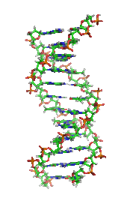
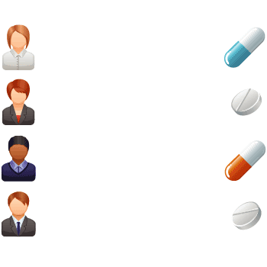

Why am I excited about data science?
Personalized medicine

Slide 28


Why am I excited about data science?
Large Language Models & Diffusion Models!

Slide 29

Overview: What is Data Science?

Slide 30
1. Introduction
Why data science?
What is data science?
What are the data?
What makes it "science"?
What are the functions?
What is a typical life cycle?
Content covered by this course

Slide 31
What are the data?

Slide 32
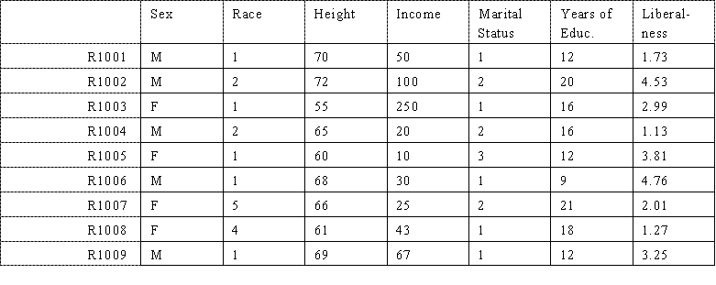
Vector/Tabular Data
Notes:
Sources:http://www.analytictech.com/networks/kindsofmatrices.htm
Need to be replaced

Slide 33
Set Data

Slide 34
Text Data
“Text mining, also referred to as text data mining, roughly equivalent to text analytics, refers to the process of deriving high-quality information from text. High-quality information is typically derived through the devising of patterns and trends through means such as statistical pattern learning. Text mining usually involves the process of structuring the input text (usually parsing, along with the addition of some derived linguistic features and the removal of others, and subsequent insertion into a database), deriving patterns within the structured data, and finally evaluation and interpretation of the output. 'High quality' in text mining usually refers to some combination of relevance, novelty, and interestingness. Typical text mining tasks include text categorization, text clustering, concept/entity extraction, production of granular taxonomies, sentiment analysis, document summarization, and entity relation modeling (i.e., learning relations between named entities).” –from wiki

Slide 35
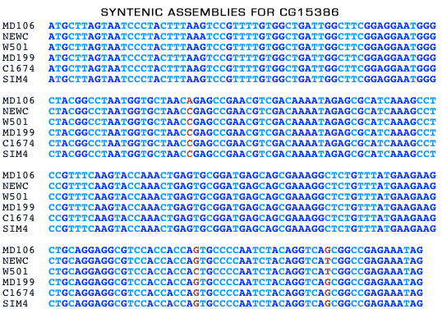
Sequence Data
Notes:
Source: http://www.dpgp.org/syntenic_assembly/

Slide 36
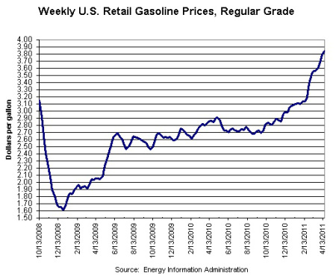
Time Series
Notes:
Source: http://swampland.time.com/2011/04/25/obamas-pump-problem-why-gas-prices-could-swing-a-close-election/

Slide 37
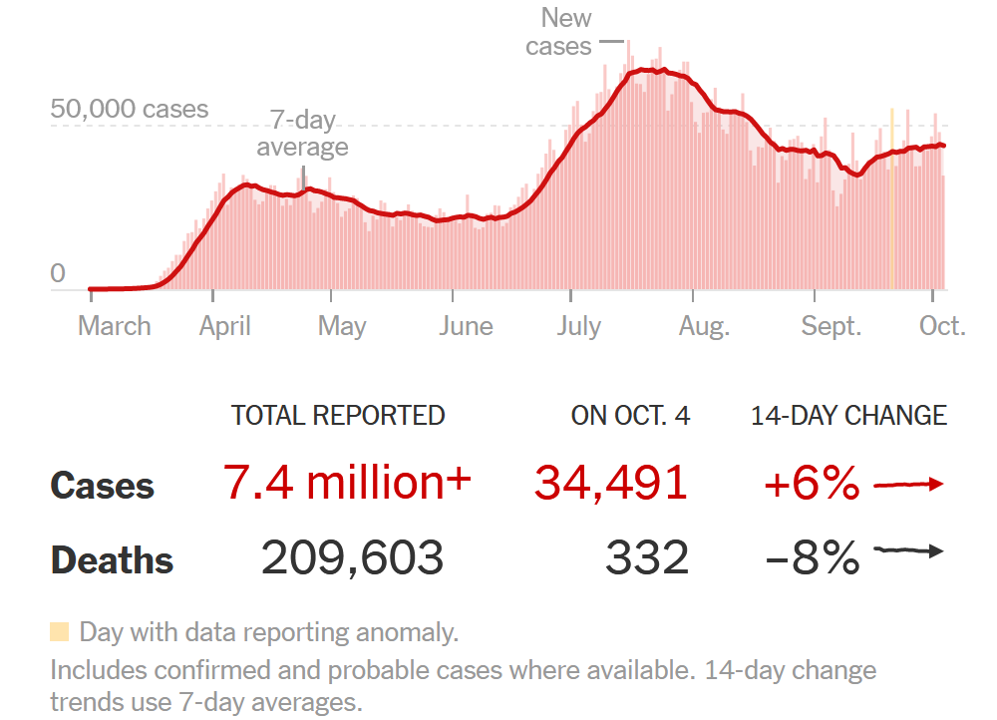
Time Series
Notes:
https://www.nytimes.com/interactive/2020/us/coronavirus-us-cases.html

Slide 38
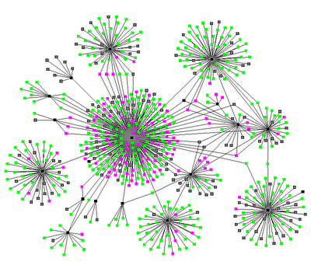
Graph / Network
Notes:
Source: http://www.thenetworkthinkers.com/2008/06/birds-of-feather-grow-fat-together.html

Slide 39
Graph / Network – Community Detection

Slide 40
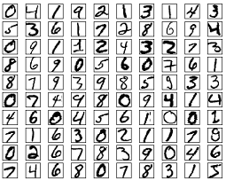
Image Data

Slide 41
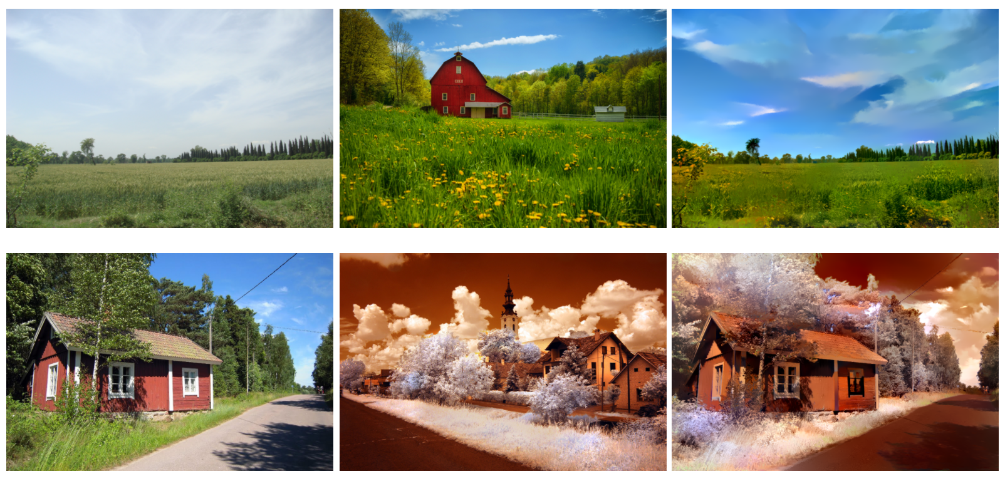

Image Data – Neural Style Transfer

Slide 42
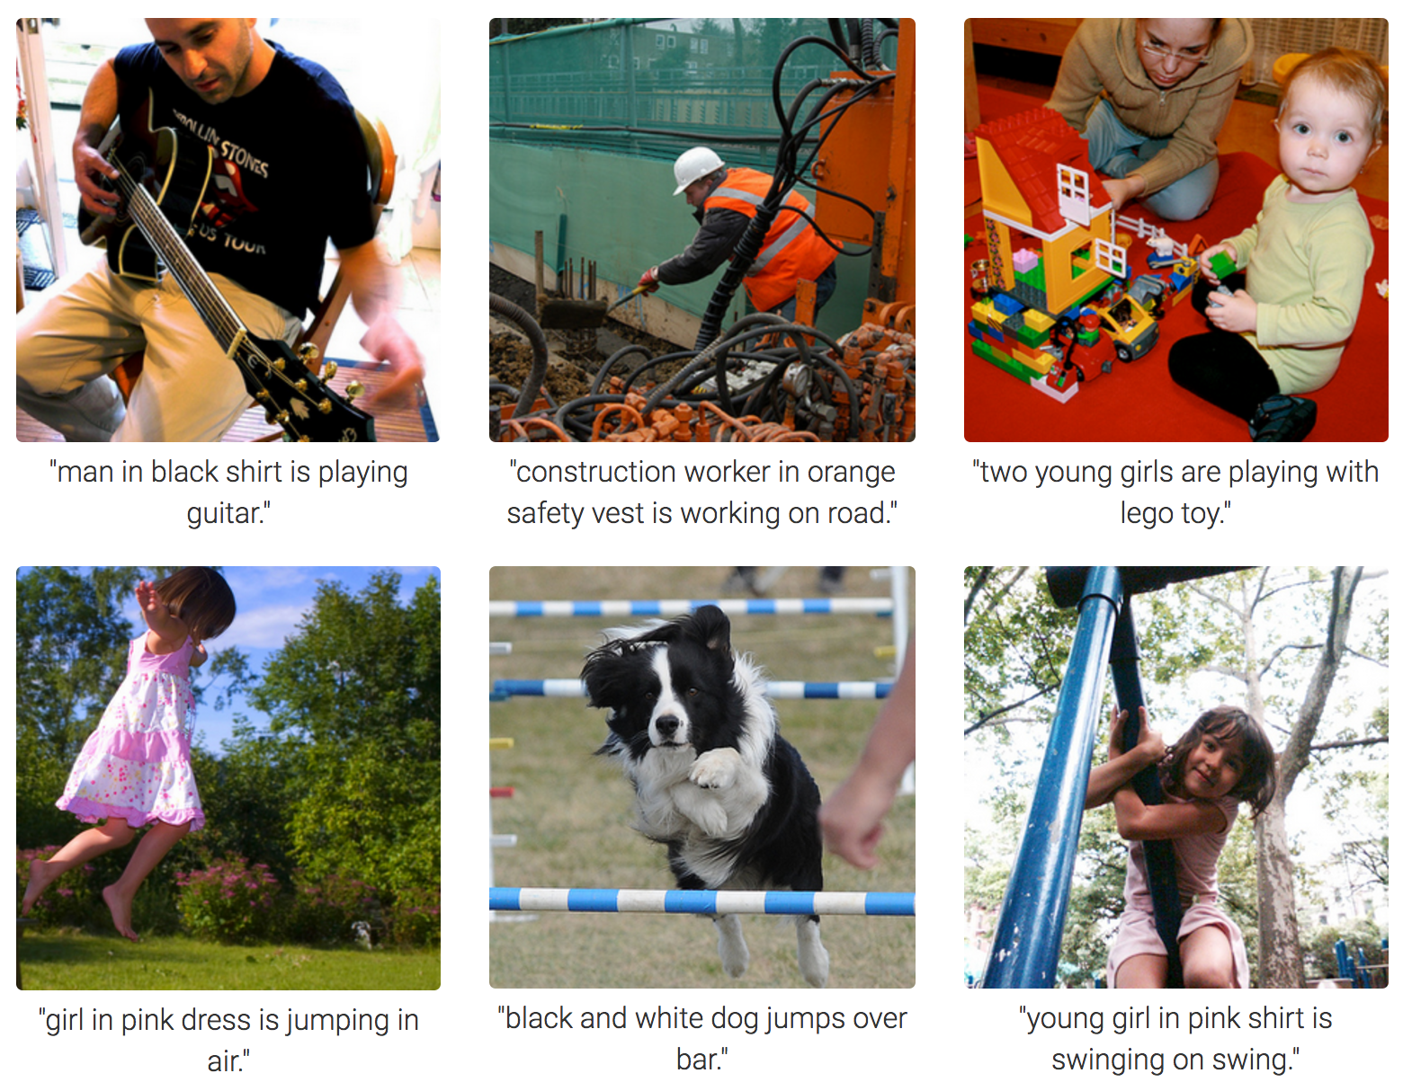
Image Data – Image Captioning

Slide 43
1. Introduction
Why data science?
What is data science?
What are the data?
What makes it "science"?
What are the functions?
What is a typical life cycle?
Content covered by this course

Slide 44
The Science Component
Question: How about the science component in data science?
Does Science Require Data?
Does Data Require Science?

Slide 45
Does science require data?
Science involves proposing hypotheses
Modern science is evidence-based: on top of hypotheses and theories, we need evidence:
evidence = experimental design + data collection.

Slide 46
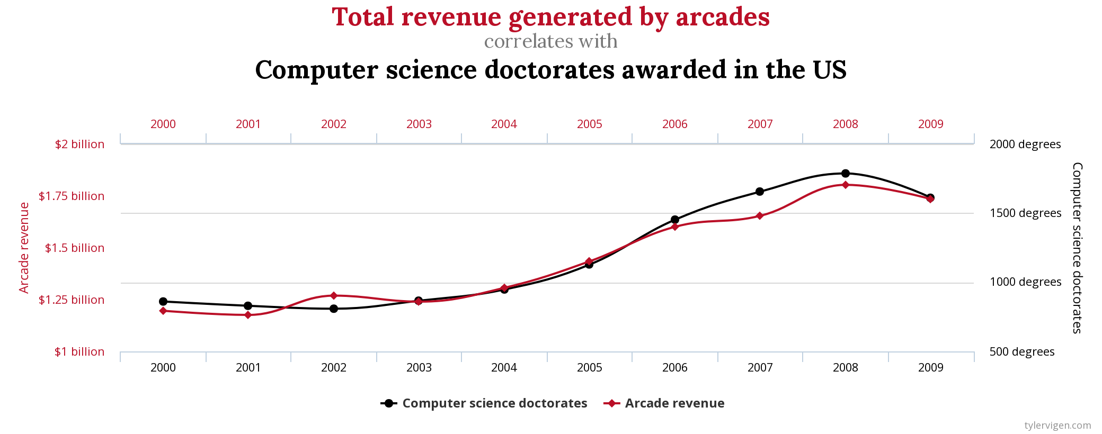
Does data require science?
Data itself doesn't tell the full story: we need the scientific method to make inference.
In other words, data itself doesn’t produce knowledge directly.
Statistical Inference
Causal Inference

Slide 47
Key message
We cannot have one without the other!

Slide 48

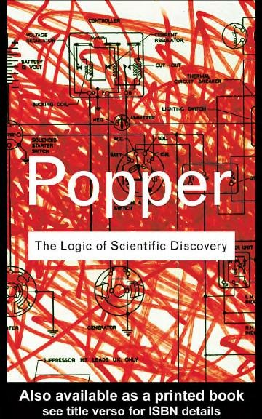
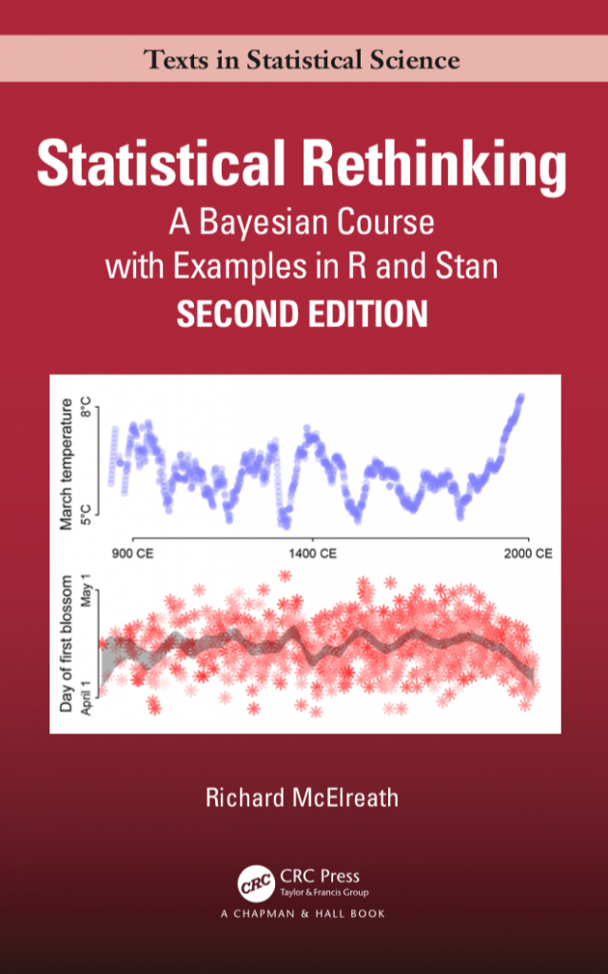
Some references if you are interested
The Book of Why, Judea Pearl, Dana Mackenzie
Statistical Rethinking, Richard McElreath
The Logic of Scientific Discovery, Karl Popper

Slide 49
Please download and install the Slido app on all computers you use
Audience Q&A Session
ⓘ Start presenting to display the audience questions on this slide.

Slide 50
What are the functions?

Slide 51
Taxonomy of data science functions
Supervised vs. unsupervised
Supervised: classification, regression
A data point = (Features (x), label (y))
Unsupervised: clustering
A data point = (Features (x))

Slide 52
Regression
The label to be predicted is continuous
Example
Housing price prediction: predict a new house price based on its living area, # of bedrooms, # of baths

Slide 53
Classification
The label to be predicted is discrete
Example
Based on an image, predict its category

Slide 54
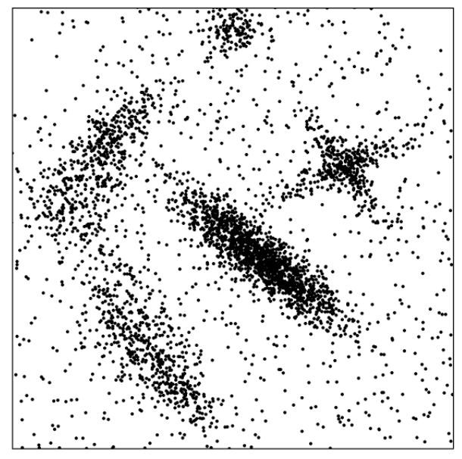
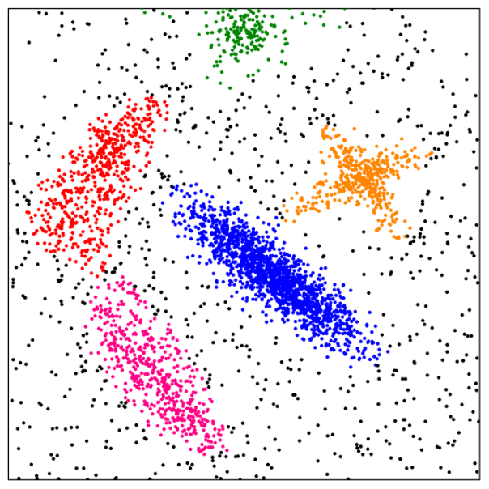
Cluster Analysis
Unsupervised learning (i.e., Class label is unknown)
Group data to form new categories (i.e., clusters), e.g., cluster houses to find distribution patterns
Principle: Maximizing intra-class similarity & minimizing interclass similarity
Example

Slide 55
Others
Similarity search
Ranking
Outlier detection
…

Slide 56
What is a typical life cycle of data science?

Slide 57
Data Science Life Cycle
The Data Science Process
Ask an interesting question
Get the Data
Explore and Preprocess the Data
Model the Data
Communicate/Visualize the Results

Slide 58
Data Science Life Cycle
The Data Science Process
Ask an interesting question
What is the scientific/practical goal?
What would you do if you had all of the data?
What do you want to predict or estimate?
Get the Data
Explore and Preprocess the Data
Model the Data
Communicate/Visualize the Results

Slide 59
Data Science Life Cycle
The Data Science Process
Ask an interesting question
How were the data sampled?
Which data are relevant?
Are there privacy issues?
Get the Data
Explore and Preprocess the Data
Model the Data
Communicate/Visualize the Results

Slide 60
Data Science Life Cycle
The Data Science Process
Ask an interesting question
Plot the data.
Are there anomalies or egregious issues?
Are there patterns?
Get the Data
Explore and Preprocess the Data
Model the Data
Communicate/Visualize the Results

Slide 61
Data Science Life Cycle
The Data Science Process
Ask an interesting question
Build a model.
Fit the model.
Validate the model.
Get the Data
Explore and Preprocess the Data
Model the Data
Communicate/Visualize the Results

Slide 62
Data Science Life Cycle
The Data Science Process
Ask an interesting question
What did we learn?
Do the results make sense?
Can we effectively tell a story?
Get the Data
Explore and Preprocess the Data
Model the Data
Communicate/Visualize the Results

Slide 63
1. Introduction
Why data science?
What is data science?
What are the data?
What are the functions?
What is a typical life cycle?
Content covered by this course

Slide 64
Course Content
Functions to be covered
Prediction/regression and classification
Clustering
Data types to be covered
Vector data
Sequence
Text
Image
Recommender System

Slide 65
Algorithm to be covered
Supervised learning
Linear Regression
Logistic Regression
KNN
SVM
Decision Tree
Neural Network
Unsupervised learning
K-means
Hierarchical clustering
DBSCAN*

Slide 66
How to learn these algorithms?
Three levels
When is it applicable?
Input, output, strengths, weaknesses, [time complexity]
How does it work?
Pseudo-code, workflows, major steps
Can work out a toy problem by pen and paper
Coding
Why does it work?
Intuition, philosophy, objective, [derivation, proof]

Slide 67
What skills are needed (in the long run)?

Slide 68
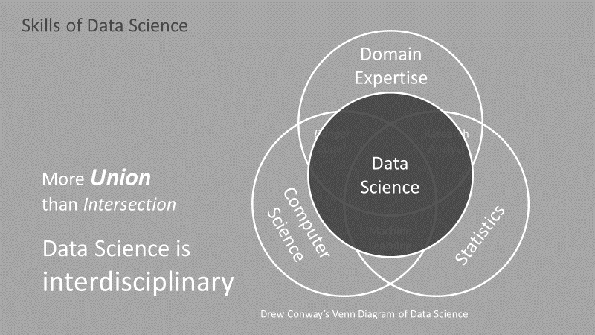

Slide 69
More Detailed View
Machine
Learning
Pattern
Recognition
Statistics
Applications
Data Science
Visualization
Algorithm
Database
Technology
High-Performance
Computing

Slide 70
Use the following as your study guide to college-level data science

Slide 71
Major Concepts Related to Probability and Statistics
Elements of Probability
Sample space, event space, probability measure
Conditional probability
Independence, conditional independence
Random variables
Cumulative distribution function, Probability mass function (for discrete random variable), Probability density function (for continuous random variable)
Expectation, variance
Some frequently used distributions
Discrete: Bernoulli, binomial, geometric, poisson
Continuous: uniform, exponential, normal
More random variables
Joint distribution, marginal distribution, joint and marginal probability mass function, joint and marginal density function
Chain rule
Bayes’ rule
Independence
Expectation, conditional expectation, and covariance

Slide 72
Major Concepts in Linear Algebra
Vectors
Addition, scalar multiplication, norm, dot product (inner product), projection, cosine similarity
Matrices
Addition, scalar multiplication, matrix-matrix multiplication, trace, eigenvalues and eigenvectors

Slide 73
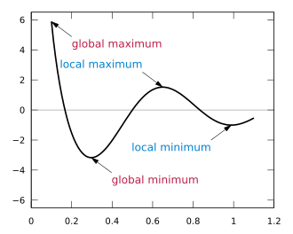
Related Concepts from Calculus
Function
Continuous, Differentiable
Derivative, partial derivative, chain rule
Second derivative
Maxima and minima

Slide 74
Optimization Related
MLE and MAP Principle
Gradient descent & stochastic gradient descent
Newton’s method
Expectation-Maximum algorithm (EM)

Slide 75
The Role of Mathematics (II)
I highly recommend you go deep into mathematics once you are in college.
It is a profound but beautiful subject, especially on the abstract level.
For our purpose, however, a basic understanding suffices.
Don't be scared away by the long list of topics, as currently you don't need to be experts in all these topics.
We will learn and understand a subset of these concepts together.
I cannot say that I am an expert in all of them without having to look up some reference materials myself.

Slide 76
Suggestions on Learning Strategies
Try to understand which concepts are really needed, and at which level these concepts are needed during lectures
Bottomline: we don't need to be experts right now (in the future you will) and we don't have to go too deep into the rabbit hole.

Slide 77
Suggestions on Learning Strategies
2. Study the concepts that are mentioned specifically and seek help from TAs, instructor, and peers whenever needed
We are here to help!
* Sometimes chatGPT can be a surprising helpful when it comes to overview of a concept

Slide 78
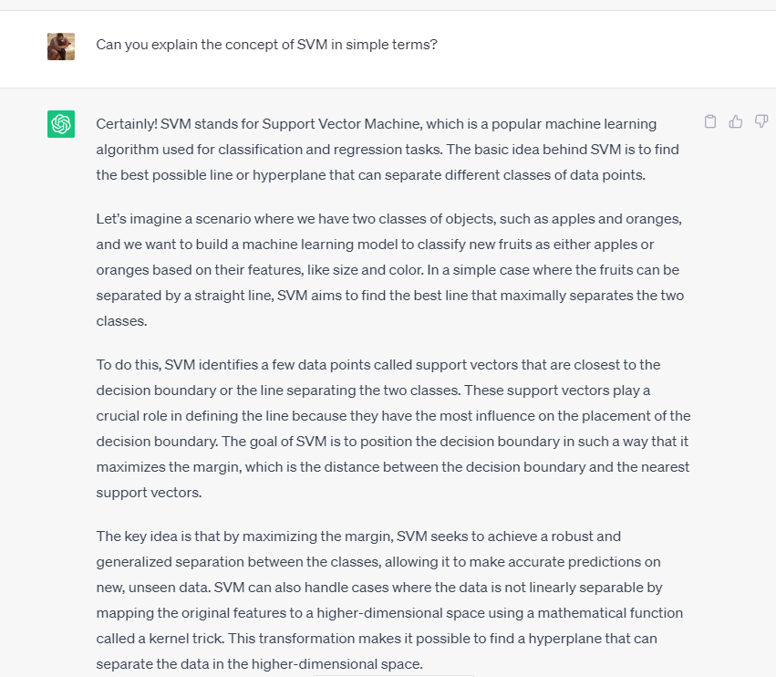
Suggestions on Learning Strategies
chatGPT can be surprisingly helpful when it comes to overview of a concept

Slide 79
Suggestions on Learning Strategies
3. make a long-term plan if you decide to go deeper in some topics

Slide 80
Good luck and have fun!

Slide 81
Please download and install the Slido app on all computers you use
Audience Q&A Session
ⓘ Start presenting to display the audience questions on this slide.

